Slide 1
C:\>ping -n 10 www.google.com
Pinging www.google.com [172.217.21.68] with 32 bytes of data:
Reply from 172.217.21.68: bytes=32 time=153ms TTL=46
Reply from 172.217.21.68: bytes=32 time=155ms TTL=46
Reply from 172.217.21.68: bytes=32 time=149ms TTL=46
Reply from 172.217.21.68: bytes=32 time=142ms TTL=46
Reply from 172.217.21.68: bytes=32 time=138ms TTL=46
Reply from 172.217.21.68: bytes=32 time=161ms TTL=46
Reply from 172.217.21.68: bytes=32 time=131ms TTL=46
Reply from 172.217.21.68: bytes=32 time=146ms TTL=46
Reply from 172.217.21.68: bytes=32 time=150ms TTL=46
Reply from 172.217.21.68: bytes=32 time=144ms TTL=46
Ping statistics for 172.217.21.68:
Packets: Sent = 10, Received = 10, Lost = 0 (0% loss),
Approximate round trip times in milli-seconds:
Minimum = 131ms, Maximum = 161ms, Average = 146ms

Slide 2
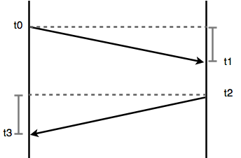

Slide 3
C:\>tracert www.google.com
Tracing route to www.google.com [216.58.198.36]
over a maximum of 30 hops:
1 1 ms <1 ms <1 ms TK2510_PLUS_14664E [192.168.1.1]
2 * * * Request timed out.
3 35 ms 22 ms 33 ms 10.222.107.129
4 35 ms 38 ms 40 ms 10.222.99.86
5 * * * Request timed out.
6 36 ms 23 ms 35 ms 10.222.99.113
7 * * * Request timed out.
8 38 ms 41 ms 37 ms 10.221.57.142
9 28 ms 38 ms 38 ms 10.221.59.1
10 45 ms 37 ms 36 ms 10.221.59.6
11 28 ms 34 ms 42 ms 10.221.58.2
12 26 ms 35 ms 39 ms 10.21.252.150
13 30 ms 35 ms 39 ms 10.21.112.20
14 144 ms 133 ms 138 ms 213.202.4.172
15 152 ms 135 ms 138 ms 213.202.4.185
16 152 ms 134 ms 129 ms 216.239.41.109
17 151 ms 137 ms 137 ms 108.170.240.55
18 187 ms 177 ms 179 ms 216.239.56.13
19 165 ms 175 ms 180 ms 108.170.245.81
20 158 ms 164 ms 346 ms 216.239.48.231
21 180 ms 178 ms 159 ms mil04s04-in-f4.1e100.net [216.58.198.36]
Trace complete.

